Slide 1
Problem and objective
With the covid 19 impact in the market, we have seen many changes in the car market. Some cars are in demand, making them costly, and some are not in order, hence cheaper. One of our clients works with small traders, who sell used cars. With the change in the market due to covid 19 impact, our client is facing problems with their previous car price valuation machine learning models. So, they are looking for new machine learning models from new data. We have to make a car price valuation model.
Problem to explore:
• Which variables are important to predict the price of variable?
• How do these variables describe the price of the Cars

Slide 2
Dataset Exploration
· The dataset contains 6384 rows and 12 columns
· Price is our dependent variable.
· We created new features from old ones.
· All columns were object data types we converted Kilometre, year and Price in numeric.
· There are no null values in the dataset.
· There were few empty cells in the dataset
· Removed empty cells
· Trimmed few columns

Slide 3
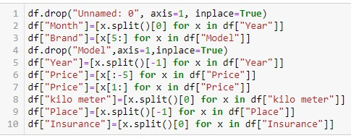
Data Cleaning & Pre-processing

Slide 4
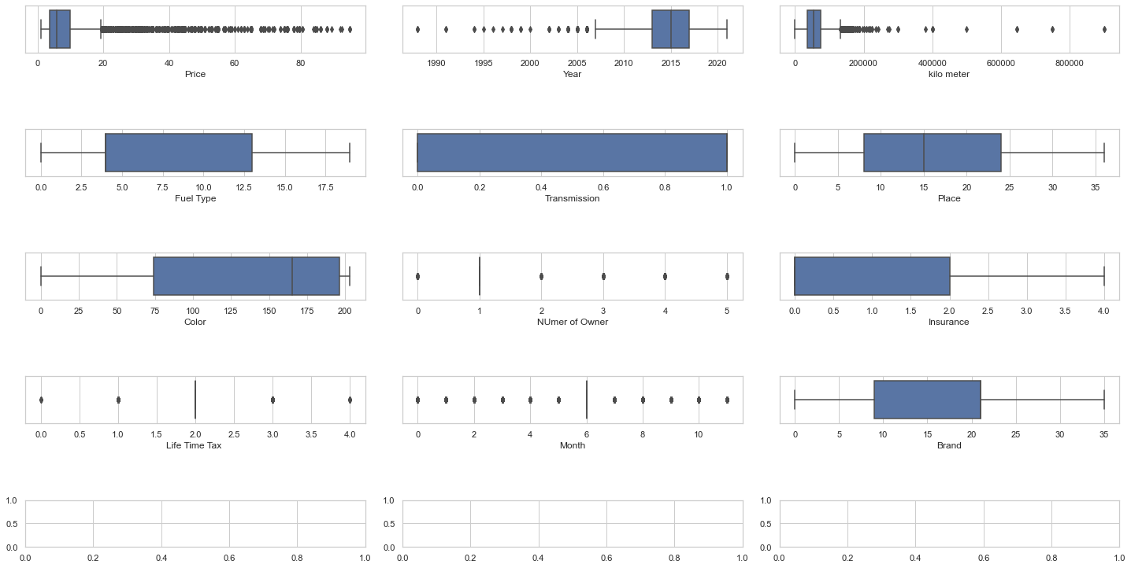
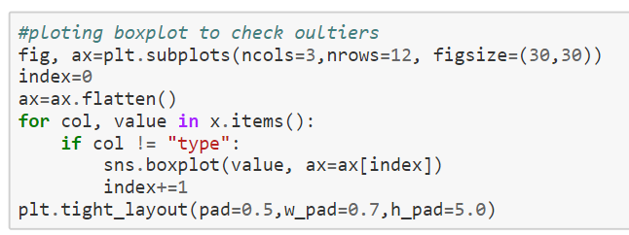
Outliers detection

Slide 5
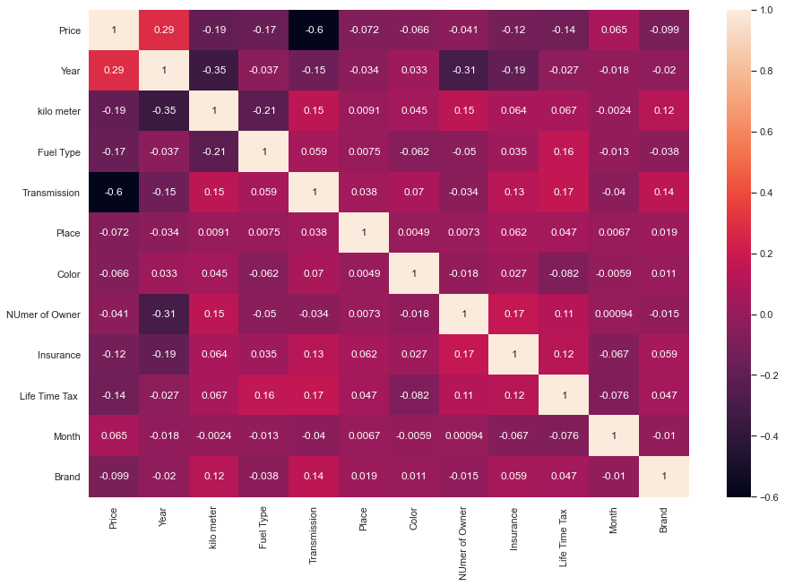
Correlation of variables using heatmap
year and transmission are most correlated with price

Slide 6
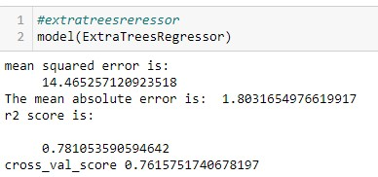
Best Model
Among the various model ExtraTreesRegressor has been proven the best model.
The r2score and the Cross-Validation score was minimum of this model.

Slide 7
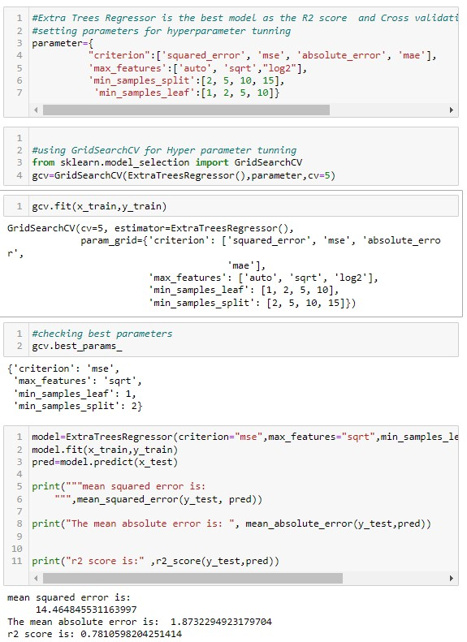
Hyperparameter Tunning
GridsearchCv has been used for hyperparameter tunning
Then the model was retrained with the best parameters

Slide 8
CONCLUSION
This research showed the model training process for the prediction of the Sale Price. One of the objectives of the paper was to check the important variable for the prediction of the price and how these variables describe the price. Through model training and evaluating its performance. ExtraTreesRegressor proved to be as best model. As the difference between the r2score and cross validation score was minimum. This project has increased my understanding of the concept. During the research I came across various challenges and while solving them I learned a lot of new things. For example. How to plot different charts. For example, I learned how to plot subplot. I learned new libraries and how to use them. I explored various methods for feature selection. Also, I came to understand how can multicollinearity can cause problem during the model training. The limitation of the solution provided is that the data carried a lot of unrealistic values. Apart from that my laptop took to much time while running certain command where I lost a lot of precious time.

